Slide 1
Week 9 Term 2
Uneven electron sharing

Slide 2
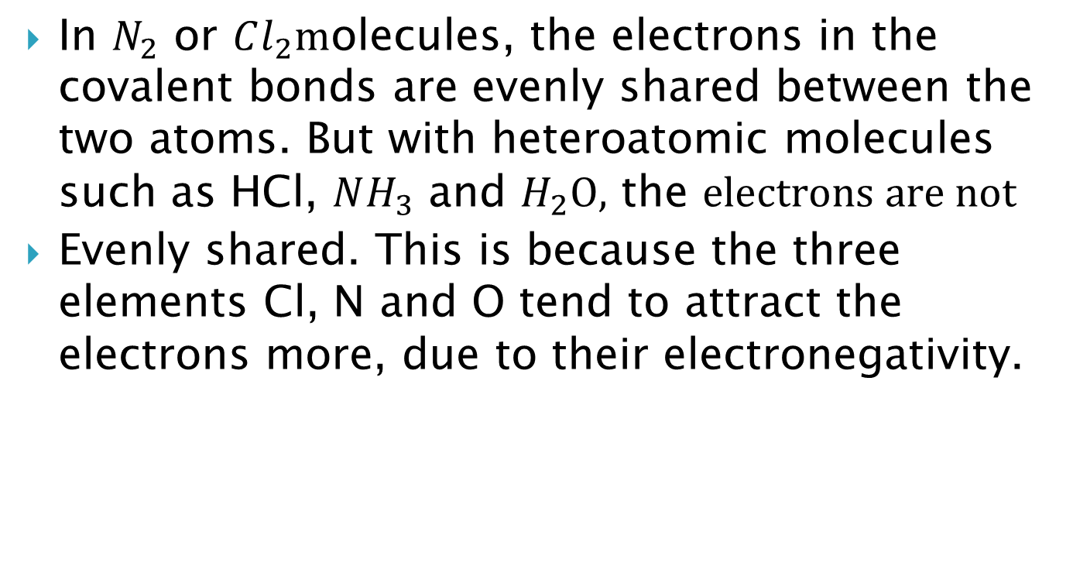
In $N_{2}$ or $Cl_{2}m$olecules, the electrons in the covalent bonds are evenly shared between the two atoms. But with heteroatomic molecules such as HCl, $NH_{3}$ and $H_{2}O,$ the $electrons are not$
Evenly shared. This is because the three elements Cl, N and O tend to attract the electrons more, due to their electronegativity.

Slide 3

Bonding electrons in HCl molecules are strongly attracted to the chlorine nucleus because chlorine is more electronegative than hydrogen. This means the electrons will spend more time at the chlorine end of the molecule and this end of the molecule will be slightly more negative.
Polar molecules are those with slight positive and slight negative charged ends to the molecule. Molecules like this are said to have a net dipole. This occurs in all molecules with a single bond dipole.
Polarity of HCl
molecule

Slide 4
The polarity of a molecule is found by drawing its shape and identifying all of its bond dipoles.
If the bond dipoles are of equal size and act in symmetrically opposing directions, then they cancel each other’s effect and the molecule has a zero net dipole and is non-polar.
If the bond dipoles are non-symmetrically arranged then they add to produce a net dipole and the molecule is polar.

Slide 5
The hydrogen-chlorine bond is a polar covalent bond. The molecule is considered to be a dipole: It has two poles of opposite charges at either end, rather like a magnet with a north and a south pole. Diatomic molecules with a net dipole are considered to be polar. Non-polar molecules such as hydrogen have a uniform charge over the whole molecule.

Slide 6
Common polar bonds are those between
O-H, N-H, C-O and C-Cl.
F >O >N=Cl >Br >C=S=I >P= H >Si
Uneven sharing of bonding electrons can occur when H or C forms covalent bonds with strong electronegative elements such as O, N, Cl and F. When this happens, the covalent bond is a polar covalent bond.

Slide 7
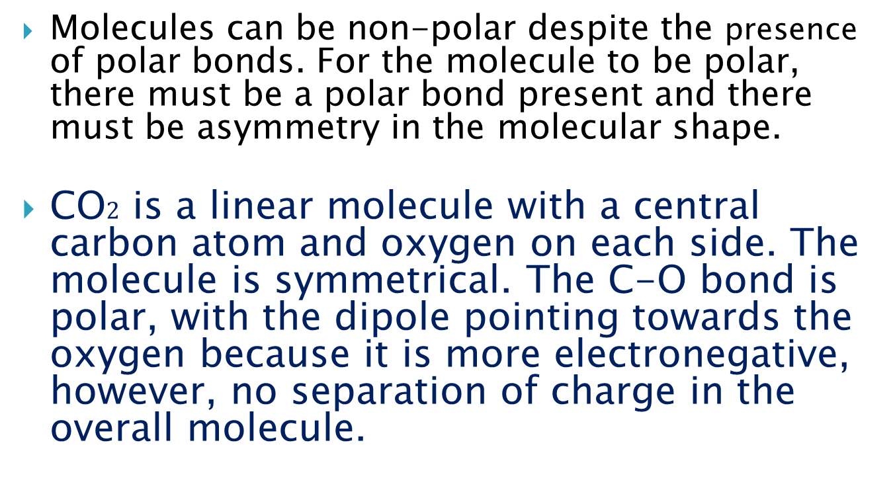
Polar and non-polar polyatomic molecules
Molecules can be non-polar despite the presence of polar bonds. For the molecule to be polar, there must be a polar bond present and there must be asymmetry in the molecular shape.
CO$2$ is a linear molecule with a central carbon atom and oxygen on each side. The molecule is symmetrical. The C-O bond is polar, with the dipole pointing towards the oxygen because it is more electronegative, however, no separation of charge in the overall molecule.

Slide 8
Polar molecules are those with slight positive and slight negative charged ends to the molecule.

Slide 9
Each oxygen will attract electrons, but as they are on either end of the molecule, the charge is distributed over the whole molecule. Although the molecule has polar covalent bonds, there is no separation of charges so no net dipole. This molecule is non-polar.

Slide 10

In water, O-H bond is polar. Oxygen at the centre and hydrogen at the bottom of the
A-shape. So, bottom end of the molecule is slightly positive. Water is asymmetrical, there is a net dipole present so water is polar.
The presence of polar covalent OH bonds and a V-shape means that the water molecule is polar.

Slide 11

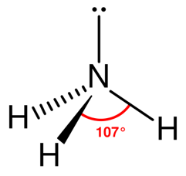
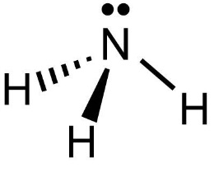
The ammonia (NH3) and tetrachloromethane (CCl4) molecules have different shapes and polar bonds. NH3 has pyramidal-shape and is polar. “N” atom at the top of pyramid is slightly negative due to its greater electronegativity. The “H” atom at the end of molecule is slightly positive. Due to asymmetry, it is a polar molecule.
CCl4 has polar bonds due to differences in electro
negativity between C and Cl. It is tetrahedral in shape with a central carbon atom. The dipole in each of the C-Cl bonds points to the Cl atom. The negative regions on chlorine in CCl4 cancel themselves out due to symmetry of molecule. CCl4 molecules are non-polar.

